Slide 1
Podatkovno rudarjenje
po CRISP-DM standardu
2. PREDAVANJE
doc. dr. Branko Kavšek
UP FAMNIT
2018/19

Slide 2
Vsebina predavanja
Uvod: Kaj in zakaj CRISP-DM?
Opis posameznih faz in nalog
Povzetek
Uvod (kaj in zakaj?) → faze in naloge → povzetek
<number> / 31

Slide 3
Kaj pomeni CRISP-DM?
CRoss-Industry Standard Process
for Data Mining
“Industrijski” standard, ki natančno določa potek analize podatkov s pomočjo
podatkovnega rudarjenja.
●●●●●● → faze in naloge → povzetek
<number> / 31

Slide 4
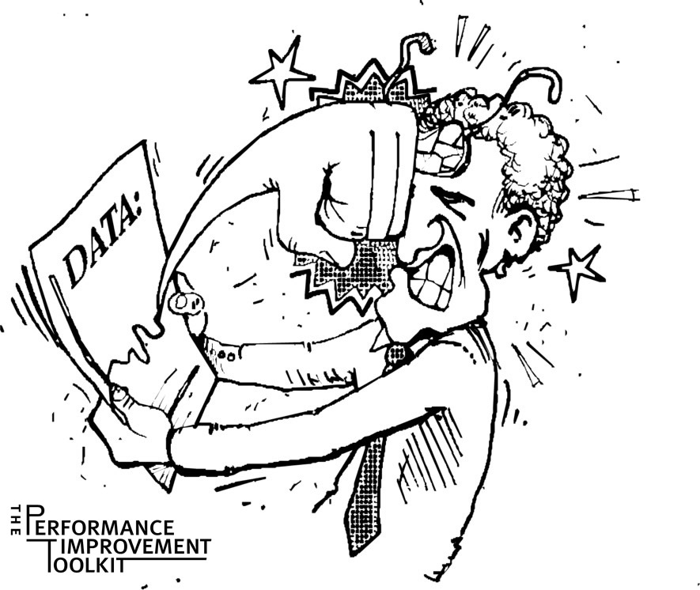
Zakaj je potrebno proces standardizirati?
Podatkovno rudarjenje je proces, ki mora biti zanesljiv in ponovljiv (s strani ljudi z malo predznanja o podatkovnem rudarjenju) !!!
●●●●●● → faze in naloge → povzetek
<number> / 31

Slide 5
Zakaj je potrebno proces standardizirati? (2)
Nudenje okvira za shranjevanje preteklih izkušenj
  projekte lahko repliciramo
Lažje planiranje in vodenje projektov
“Faktor udobja” za nove uporabnike
  dokazuje zrelost podatkovnega rudarjenja,
  zmanjšuje odvisnost od t.i. super-strokovnjakov.
●●●●●● → faze in naloge → povzetek
<number> / 31

Slide 6
Kako je prišlo do standardizacije?
(zgodovinski vidik)
Iniciativa podana s strani treh takratnih izkušenejših podjetij na področju podatkovnega rudarjenja:
  Daimler Chrysler (kasneje Daimler-Benz), SPSS (kasneje ISL), NCR;
Razvoj in dopolnitve na številnih workshop-ih (med leti 1997 in 1999);
K procesnemu modelu prispevalo več kot 300 organizacij;
Leta 1999 – izide CRISP-DM 1.0;
Trenutno več kot 200 članov interesne skupine (SIG) CRISP-DM:
  Ponudniki: SPSS, NCR, IBM, SAS, SGI, Data Distilleries, Syllogic, itd.
  Dobavitelji sistemov/svetovalci: Cap Gemini, ICL Retail, Deloitte & Touche, itd.
  Uporabniki: BT, ABB, Lloyds Bank, AirTouch, Experian, itd.
●●●●●● → faze in naloge → povzetek
<number> / 31

Slide 7

CRISP-DM je:
  Ne-lastniški
  Neodvisen od aplikacije/problema
  Neodvisen od orodja/programa
  Osredotočen na poslovne
  probleme
    pa tudi na tehnični vidik
    analize same
  Ogrodje, ki služi kot vodilo
  Baza preteklih izkušenj
    primeri “uspešnih” analiz (template)
●●●●●● → faze in naloge → povzetek
<number> / 31

Slide 8
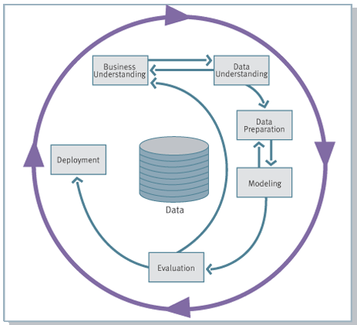
CRISP-DM: pregled
Vir: https://en.wikipedia.org/wiki/Cross_Industry_Standard_Process_for_Data_Mining
Podatkovno rudarjenje kot metodologija
Procesni model
Za vsakogar
S “komplet” navodili
V ciklu iz 6-ih faz
●●●●●● → faze in naloge → povzetek
<number> / 31

Slide 9
Vsebina predavanja
Uvod: Kaj in zakaj CRISP-DM?
Opis posameznih faz in nalog
Povzetek
Uvod (kaj in zakaj?) → faze in naloge → povzetek
<number> / 31

Slide 10
CRISP-DM: faze
Razumevanje problema:
razumevanje ciljev in potreb projekta, definicija problema za podatkovno rudarjenje;
Razumevanje podatkov:
začetno zbiranje in spoznavanje podatkov, vprašanja glede kakovosti zbranih podatkov;
Priprava podatkov:
izbor tabel, atributov, primerov; preoblikovanja in čiščenje podatkov;
Modeliranje:
izbor ustreznih tehnik modeliranja in njihova aplikacija, nastavljanje parametrov;
Evalvacija (ocena modelov):
ali smo zadovoljili cilje in potrebe projekta?, ocena – v kolikšni meri smo jih zadovoljili;
Predaja končnemu uporabniku:
predaja/implementacija modela z razlago – tako, da je celoten proces ponovliv;
Uvod (kaj in zakaj?) → faze in naloge → povzetek
<number> / 31

Slide 11
Posamezne faze in naloge
Razumevanje
problema
Razumevanje
podatkov
Priprava
podatkov
Modeliranje
Evalvacija
Predaja
Določiti cilje
projekta
Zbrati začetne
podatke
Izbrati
podatke
Izbrati tehniko
modeliranja
Oceniti
rezultate
Planirati
predajo
Oceniti trenutno
situacijo
Opisati
podatke
Prečistiti
podatke
Načrtati potek
testiranja
Oceniti celoten
proces
Spremljanje in
vzdrževanje
Določiti cilje
pod. rudarjenja
Raziskati
podatke
Sestaviti
podatke
Zgraditi
model
Sledeči koraki?
Narediti končno
poročilo
Narediti
projektni plan
Preveriti kakovost
podatkov
Integrirati
podatke
Oceniti kakovost
modela
Oceniti uspeh
celotnega projekta
“Formatirati”
podatke
Uvod (kaj in zakaj?) → faze in naloge → povzetek
<number> / 31

Slide 12
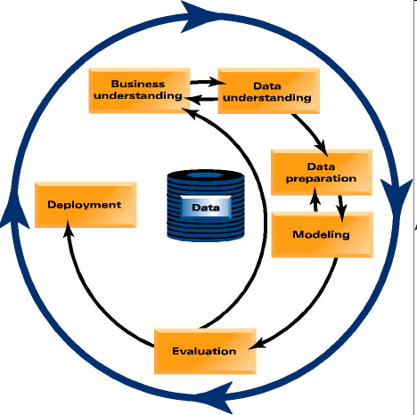
Phase 1. Business Understanding
Statement of Business Objective
Statement of Data Mining Objective
Statement of Success Criteria
Focuses on understanding the project objectives and requirements from a business perspective, then converting this knowledge into a data mining problem definition and a preliminary plan designed to achieve the objectives
<number> / 31

Slide 13
Phase 1. Business Understanding
Determine business objectives
- thoroughly understand, from a business perspective, what the client really wants to accomplish
- uncover important factors, at the beginning, that can influence the outcome of the project
- neglecting this step is to expend a great deal of effort producing the right answers to the wrong questions
Assess situation
- more detailed fact-finding about all of the resources, constraints, assumptions and other factors that should be considered
- flesh out the details
<number> / 31

Slide 14
Phase 1. Business Understanding
Determine data mining goals
- a business goal states objectives in business terminology
- a data mining goal states project objectives in technical terms
ex) the business goal: “Increase catalog sales to existing customers.”
a data mining goal: “Predict how many widgets a customer will buy, given their purchases over the past three years, demographic information (age, salary, city) and the price of the item.”
Produce project plan
- describe the intended plan for achieving the data mining goals and the business goals
- the plan should specify the anticipated set of steps to be performed during the rest of the project including an initial selection of tools and techniques
<number> / 31

Slide 15
Phase 2. Data Understanding
  Explore the Data
  Verify the Quality
  Find Outliers
Starts with an initial data collection and proceeds with activities in order to get familiar with the data, to identify data quality problems, to discover first insights into the data or to detect interesting subsets to form hypotheses for hidden information.
<number> / 31

Slide 16
Phase 2. Data Understanding
Collect initial data
- acquire within the project the data listed in the project resources
- includes data loading if necessary for data understanding
- possibly leads to initial data preparation steps
- if acquiring multiple data sources, integration is an additional issue, either here or in the later data preparation phase
Describe data
- examine the “gross” or “surface” properties of the acquired data
- report on the results
<number> / 31

Slide 17
Phase 2. Data Understanding
Explore data
- tackles the data mining questions, which can be addressed using querying, visualization and reporting including:
distribution of key attributes, results of simple aggregations
relations between pairs or small numbers of attributes
properties of significant sub-populations, simple statistical analyses
- may address directly the data mining goals
- may contribute to or refine the data description and quality reports
- may feed into the transformation and other data preparation needed
Verify data quality
- examine the quality of the data, addressing questions such as:
“Is the data complete?”, Are there missing values in the data?”
<number> / 31

Slide 18
Phase 3. Data Preparation
Takes usually over 90% of the time
- Collection
- Assessment
- Consolidation and Cleaning
- Data selection
- Transformations
  Covers all activities to construct the final dataset from the initial raw data. Data preparation tasks are likely to be performed multiple times and not in any prescribed order. Tasks include table, record and attribute selection as well as transformation and cleaning of data for modeling tools.
<number> / 31

Slide 19
Phase 3. Data Preparation
Select data
- decide on the data to be used for analysis
- criteria include relevance to the data mining goals, quality and technical constraints such as limits on data volume or data types
- covers selection of attributes as well as selection of records in a table
Clean data
- raise the data quality to the level required by the selected analysis techniques
- may involve selection of clean subsets of the data, the insertion of suitable defaults or more ambitious techniques such as the estimation of missing data by modeling
<number> / 31

Slide 20
Phase 3. Data Preparation
Construct data
- constructive data preparation operations such as the production of derived attributes, entire new records or transformed values for existing attributes
Integrate data
- methods whereby information is combined from multiple tables or records to create new records or values
Format data
- formatting transformations refer to primarily syntactic modifications made to the data that do not change its meaning, but might be required by the modeling tool
<number> / 31

Slide 21
Phase 4. Modeling
Select the modeling technique
(based upon the data mining objective)
Build model
(Parameter settings)
Assess model (rank the models)
Various modeling techniques are selected and applied and their parameters are calibrated to optimal values. Some techniques have specific requirements on the form of data. Therefore, stepping back to the data preparation phase is often necessary.
<number> / 31

Slide 22
Phase 4. Modeling
Select modeling technique
- select the actual modeling technique that is to be used
ex) decision tree, neural network
- if multiple techniques are applied, perform this task for each techniques separately
Generate test design
- before actually building a model, generate a procedure or mechanism to test the model’s quality and validity
ex) In classification, it is common to use error rates as quality measures for data mining models. Therefore, typically separate the dataset into train and test set, build the model on the train set and estimate its quality on the separate test set
<number> / 31

Slide 23
Phase 4. Modeling
Build model
- run the modeling tool on the prepared dataset to create one or more models
Assess model
- interprets the models according to his domain knowledge, the data mining success criteria and the desired test design
- judges the success of the application of modeling and discovery techniques more technically
- contacts business analysts and domain experts later in order to discuss the data mining results in the business context
- only consider models whereas the evaluation phase also takes into account all other results that were produced in the course of the project
<number> / 31

Slide 24
Phase 5. Evaluation
Evaluation of model
- how well it performed on test data
Methods and criteria
- depend on model type
Interpretation of model
- important or not, easy or hard depends on algorithm
Thoroughly evaluate the model and review the steps executed to construct the model to be certain it properly achieves the business objectives. A key objective is to determine if there is some important business issue that has not been sufficiently considered. At the end of this phase, a decision on the use of the data mining results should be reached
<number> / 31

Slide 25
Phase 5. Evaluation
Evaluate results
- assesses the degree to which the model meets the business objectives
- seeks to determine if there is some business reason why this model is deficient
- test the model(s) on test applications in the real application if time and budget constraints permit
- also assesses other data mining results generated
- unveil additional challenges, information or hints for future directions
<number> / 31

Slide 26
Phase 5. Evaluation
Review process
- do a more thorough review of the data mining engagement in order to determine if there is any important factor or task that has somehow been overlooked
- review the quality assurance issues
ex) “Did we correctly build the model?”
Determine next steps
- decides how to proceed at this stage
- decides whether to finish the project and move on to deployment if appropriate or whether to initiate further iterations or set up new data mining projects
- include analyses of remaining resources and budget that influences the decisions
<number> / 31

Slide 27
Phase 6. Deployment
Determine how the results need to be utilized
Who needs to use them?
How often do they need to be used
Deploy Data Mining results by
Scoring a database, utilizing results as business rules,
interactive scoring on-line
The knowledge gained will need to be organized and presented in a way that the customer can use it. However, depending on the requirements, the deployment phase can be as simple as generating a report or as complex as implementing a repeatable data mining process across the enterprise.
<number> / 31

Slide 28
Phase 6. Deployment
Plan deployment
- in order to deploy the data mining result(s) into the business, takes the evaluation results and concludes a strategy for deployment
- document the procedure for later deployment
Plan monitoring and maintenance
- important if the data mining results become part of the day-to-day business and it environment
- helps to avoid unnecessarily long periods of incorrect usage of data mining results
- needs a detailed on monitoring process
- takes into account the specific type of deployment
<number> / 31

Slide 29
Phase 6. Deployment
Produce final report
- the project leader and his team write up a final report
- may be only a summary of the project and its experiences
- may be a final and comprehensive presentation of the data mining result(s)
Review project
- assess what went right and what went wrong, what was done well and what needs to be improved
<number> / 31

Slide 30
Vsebina predavanja
Uvod: Kaj in zakaj CRISP-DM?
Opis posameznih faz in nalog
Povzetek
Uvod (kaj in zakaj?) → faze in naloge → povzetek
<number> / 31

Slide 31
Povzetek – zakaj CRISP-DM?
Proces podatkovnega rudarjenja mora biti zanesljiv in ponovljiv (s strani ljudi z omejenim znanjem podatkovnega rudarjenja);
CRISP-DM zagotavlja enoten okvir za:
  smernice;
  dokumentacijo primerov;
CRISP-DM je fleksibilen glede na razlike:
  različni (poslovni) problemi;
  različni podatki;
Uvod (kaj in zakaj?) → faze in naloge → povzetek
<number> / 31

